Slide 1
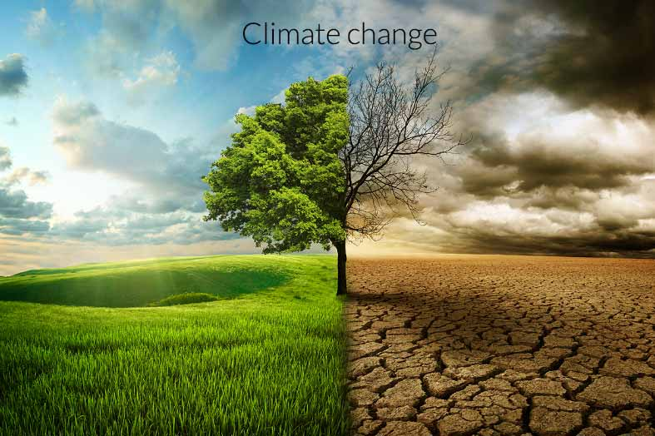
Environman

Slide 2
Environman
By: Nikolas and Konstantinos

Slide 12
You must protect the environment!!!

Slide 13
There’s no planet B!!!

Slide 14
Make the different!!!

