Slide 1
THE WIDER WORLD
CONNECTIONS AND LINKS

Slide 2
By Melina and Lenio

Slide 3
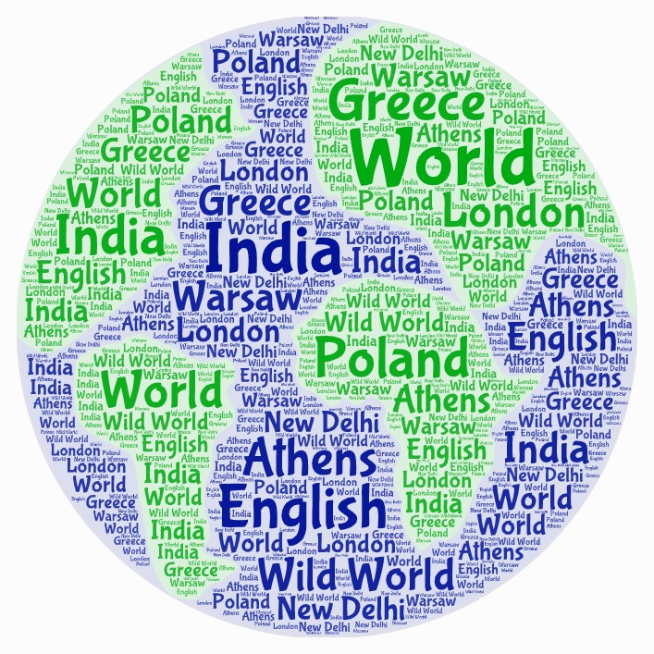
By Christina

Slide 4
By Vasiliki, Marilia, Mariliza

Slide 5
By Panagiotis

