Slide 1
The most famous athletes of Greece

Slide 2
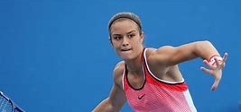
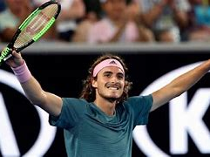
Tennis
Stefanos Tsitsipas. He is the best greek tennis player of all times.Maria Sakkari. She is 4th best tennis player on the world.

Slide 3
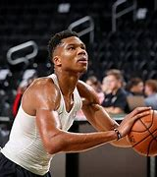
Basket
Giannis Antetokoumpo. He is one of the 75 best players on the NBA of all times.

Slide 4
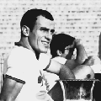
Football
Mimis Domazos. In 2003 he was voted as the second best greek football player.

Slide 5
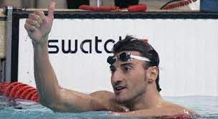
Swimming
Giannis Kokkodis. He has won a bronze medal in Berlin for the 4x200 freestyle.

Slide 6
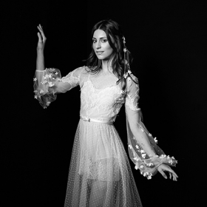
Ballet
Eleana Andreoudi. She is a dancer at the Natonal Opera. She has been awarded with many international awrds.

Slide 7
Thank you!!

Slide 8
By Evi and Melina

